Slide 1
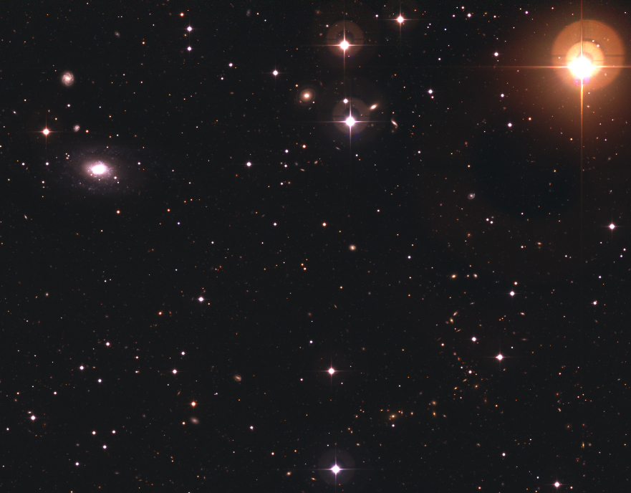


Maud Galametz
September, the 14th, 2009
The International conference ‘’Nearby Dwarf Galaxies’’
Studying the dust properties of dwarf galaxies at submm wavelengths with LABOCA
Collaborators:
Suzanne Madden Frédéric Galliano Sacha Hony Frédéric Schuller Alexandre Beelen George Bendo Marc Sauvage Andreas Lundgren Nicolas Billiot

Slide 2
Contents
1- What do we know of dust properties in dwarfs ?
2- The LABOCA images
3- SED modelling and results
4- Evolution of the D/G mass ratio with submm
constraints
5- Summary

Slide 3
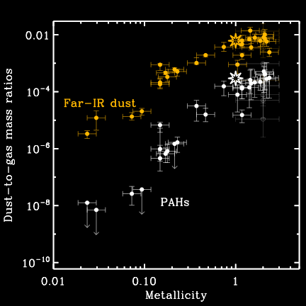
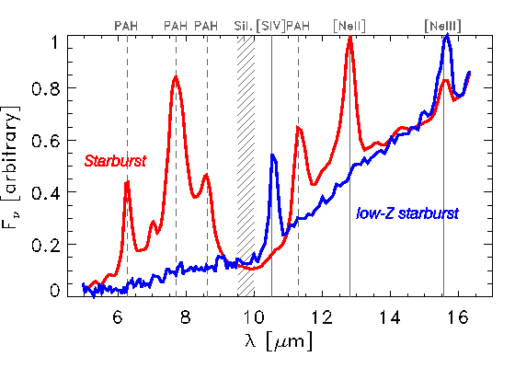
1
Dust properties in dwarf galaxies
Dwarf galaxies
Building blocks of larger galaxies
Could present analogies with galaxies of the Early Universe
Their SED is different from dustier galaxies
    Less PAH features
    Usually peaks at shorter wavelengths
    Lower Dust-to-gas mass ratio
Galliano et al. 2008

Slide 4
1
Dust properties in dwarf galaxies
SED : Probe the dust grain distribution and
temperature
Excess in submm: presence of very cold dust ?
→ huge mass of dust missing
Wavelength
Bendo et al. 2006
Galliano et al. 2005

Slide 5
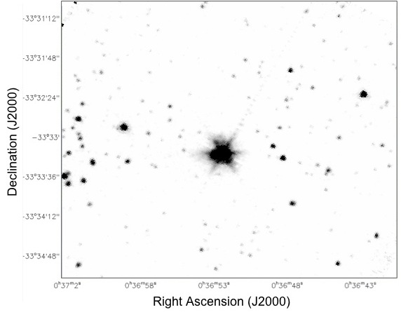
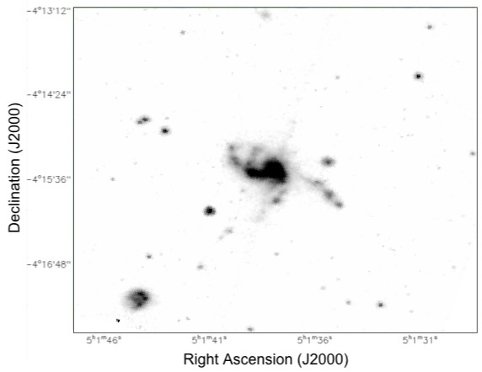
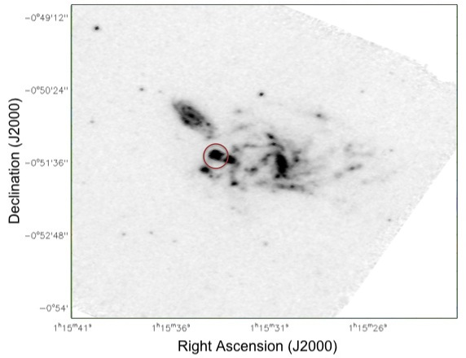
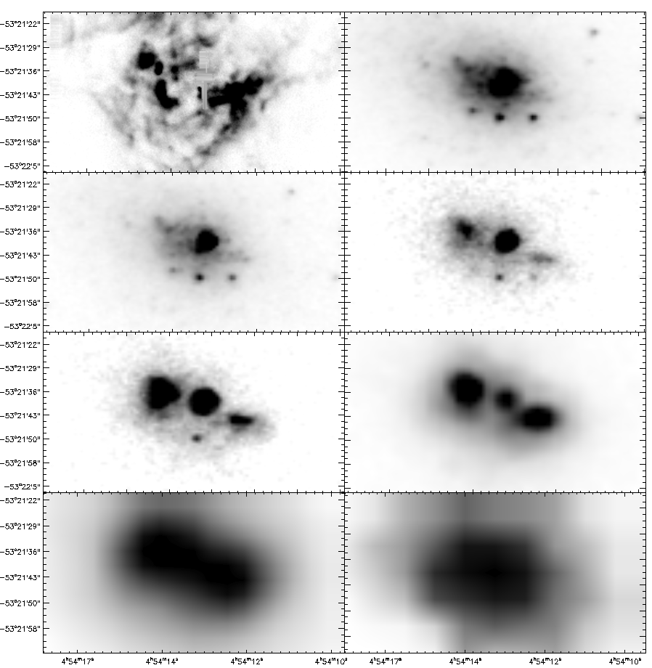
2
The LABOCA images
The sample, here observed by Spitzer
NGC 1705
Haro11
3.6 μm
Hα
3.6 μm
Mrk 1089
4.5 μm
5.8 μm
8 μm
UM 311
8 μm
24 μm
8 μm
70 μm
160 μm

Slide 6
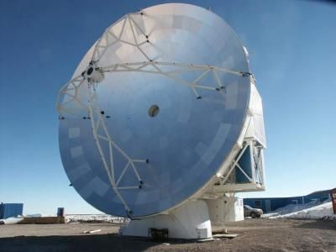
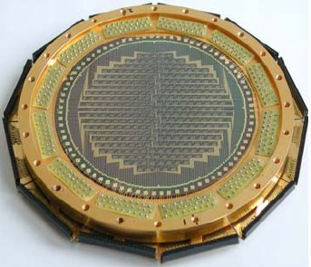
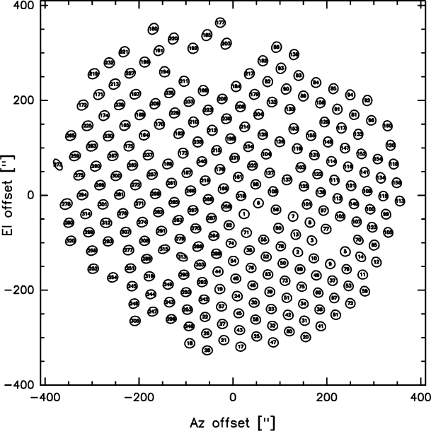
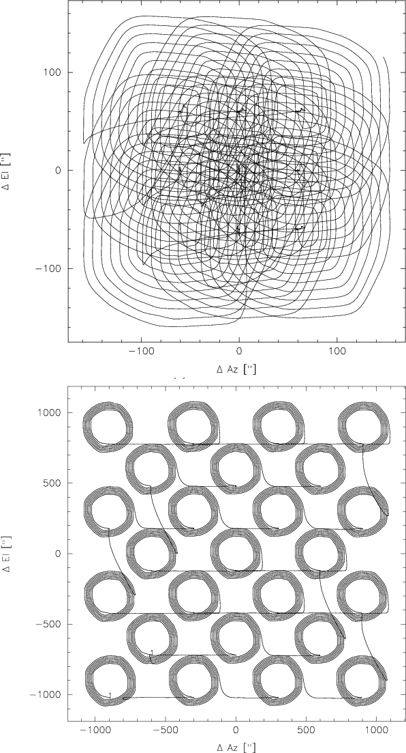
2
The LABOCA images
LABOCA
APEX, Atacama desert, Chile
Observations at 870 μm
~300 composite bolometers
Beam: 18.6’’
- Field of view: 11.4 ’
Sample observed in Raster spiral-mode

Slide 7
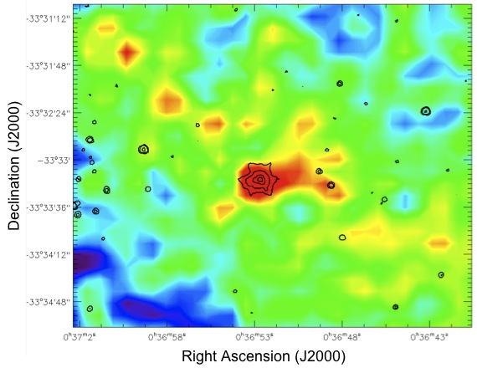
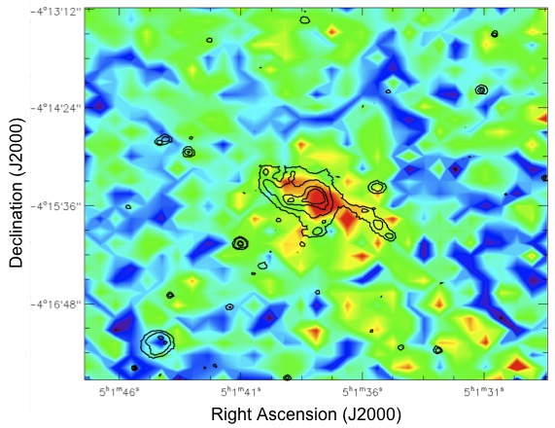
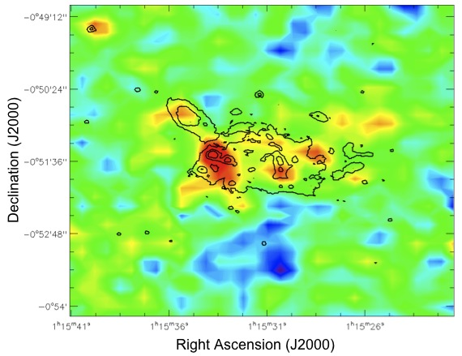
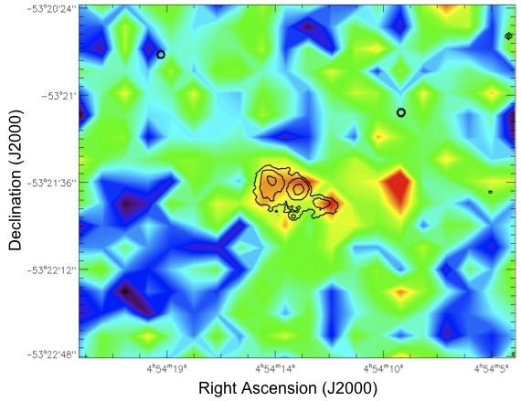
2
The LABOCA images
Haro11
Mrk 1089
UM 311
NGC 1705
Galametz et al. 2009 submitted

Slide 8
3
SED modelling and results
Fiducial model
Based on the Galliano et al. 2008 model
Sources of excitation: ISRF, shape of the Galaxy (Mathis et al., 1983)
Sources of IR emission: dust, PAHs, stars.
- Dust and PAHs: Grain properties of Zubko et al., 2004
Optical properties of PAHs of Draine & Li, 2007
- Power law relation: dM_{dust}(U)∞U^{-α} (Dale et al., 2001)
- Substract the stellar component, synthesised from the NIR points
using PEGASE.
Galametz et al. 2009 submitted
Notes:
prescription of Dale et al. 2001: assume a power-law distribution of Mdust over the heating environment intensities (U) (2001): dM(U ) ∝ U − α

Slide 9
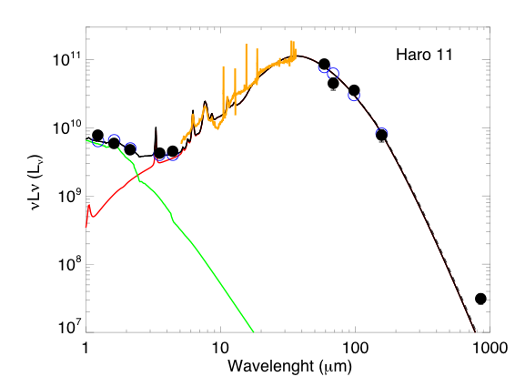
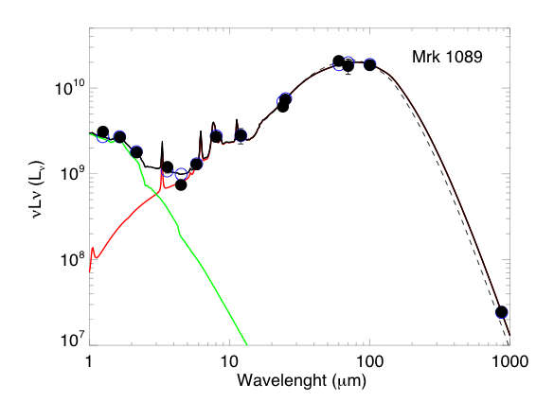
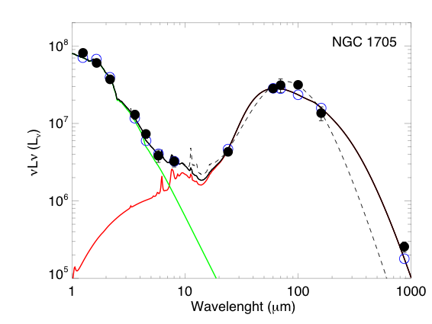
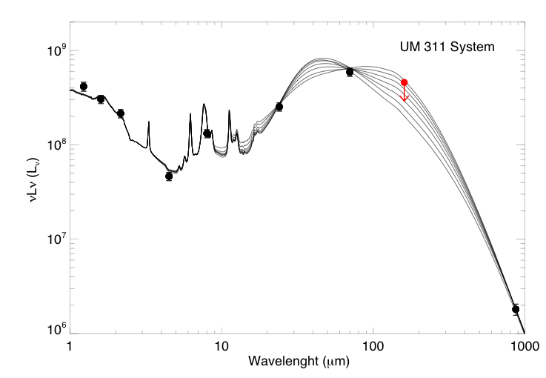
3
SED modelling and results
Fiducial model
Data: 2MASS, IRAS, IRAC, MIPS, LABOCA

Slide 10
3
SED modelling and results
Possible hypothesis to explain the excess
Hot (100K) dust with a lower emissivity index (β=1)
Lisenfeld et al. 2001
Extra ISM component heated at U=U_{min}
Draine et al. 2007
Change in dust emissivity as a function of wavelength
Dupac et al. 2003, Meny et al. 2007
Adding a very cold (~ 10K) dust component
Galliano et al. 2003, 2005

Slide 11
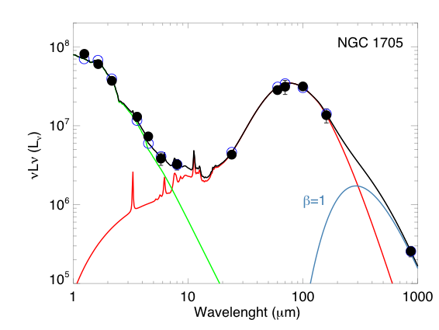
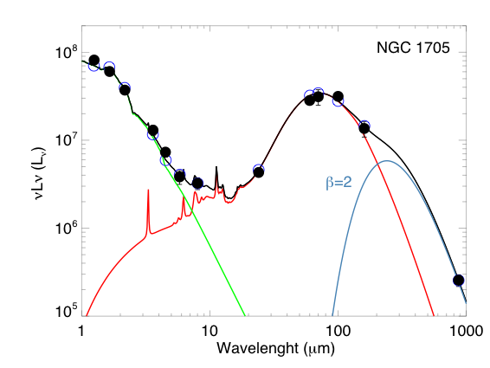
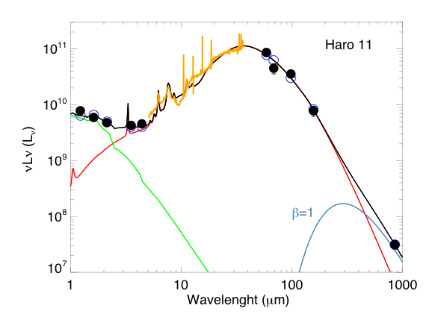
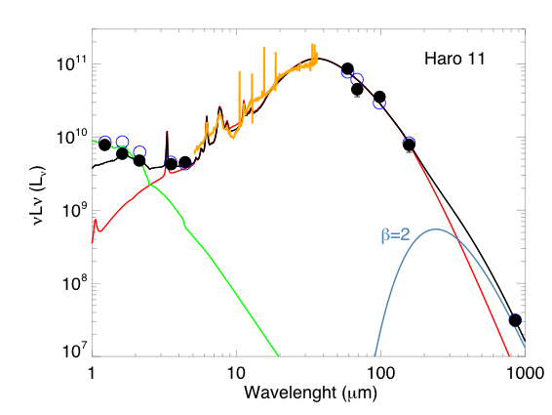
3
SED modelling and results
Refinement of the model
Haro 11
NGC 1705

Slide 12
3
SED modelling and results
Dust mass and dust-to-gas mass ratios
Increase in the total mass of dust with submm constraints
Comparison with the Dust - to - Gas mass ratio expected by chemical evolution models.
Mrk 1089 |  | Haro 11 |  |  | NGC 1705
M_{dust} _{without submm} | M_{dust with submm} | M_{dust} _{without submm} | M_{dust with submm} |  | M_{dust} _{without submm} | M_{dust with submm}
 |  |  | β=2 | β=1 |  | β=2 | β=1
3 x 10⁷ | 5.1 x 10⁷ | 6.2 x 10⁶ | 1.3 x 10⁸ | 2 x 10⁷ | 2.9 x 10⁴ | 1.3 x 10⁶ | 1.7 x 10⁵
Dust - to - HI mass ratios
10⁻³ | 1.9 x 10⁻³ | 6 x 10⁻² | 1.3 ! | 0.2 | 7 x 10⁻⁴ | 2.8 x 10⁻² | 4.1 x 10⁻³
Dust - to - Gas mass ratios expected
~ 10⁻³ |  | ~ 10⁻³ |  |  | 2 - 5 x 10⁻³

Slide 13

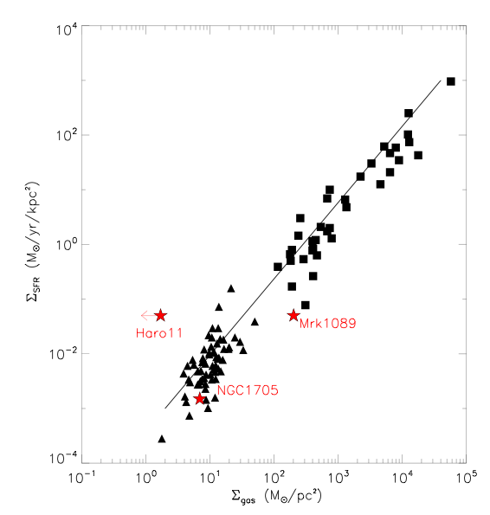
3
SED modelling and results
Star formation Rate
Kennicutt 1998
Consistent for two galaxies
Discrepancy for Haro 11
Amount of gas mass required?
10¹⁰ M again !

Slide 14
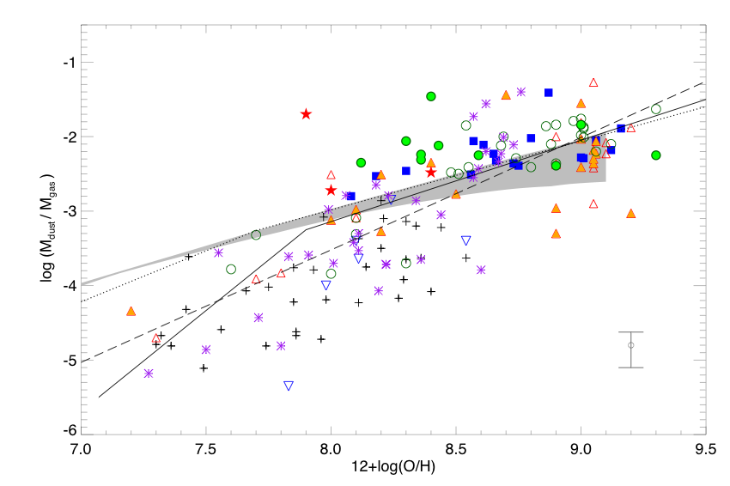
4
Evolution of the D/G mass ratio
Dust-to-gas mass ratios = f(Z)
- Datasets from: Lisenfeld & Ferrara, 1998, James et al. 2002, Hirashita et al. 2008,
Engelbracht et al., 2008, Galliano et al. 2008, Draine et al., 2007.
- Models from: Edmunds, 2001, Galliano et al. 2008
Galametz et al. 2009B in prep
Notes:
Describe the importance of this parameter.

Slide 15
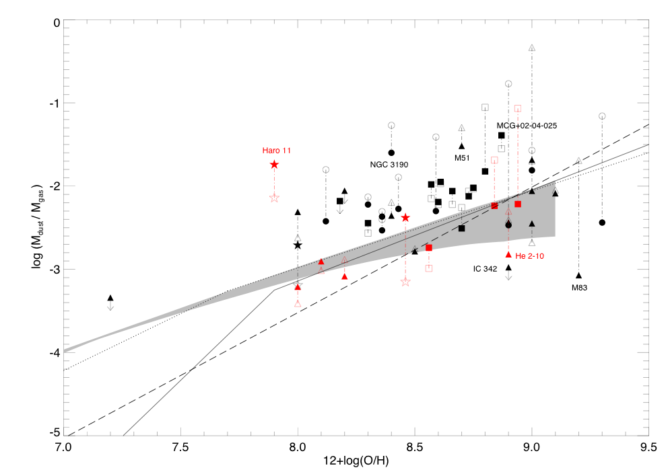
4
Evolution of the D/G mass ratio
Dust-to-gas mass ratios = f(Z)
- Use the same modelling process
- Run with and without submm constraints
Galametz et al. 2009B in prep

Slide 16
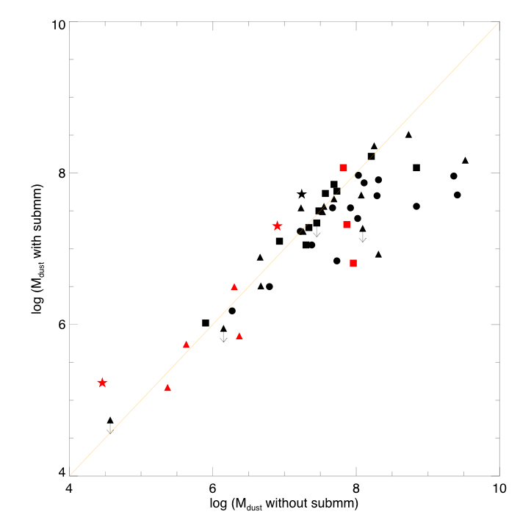
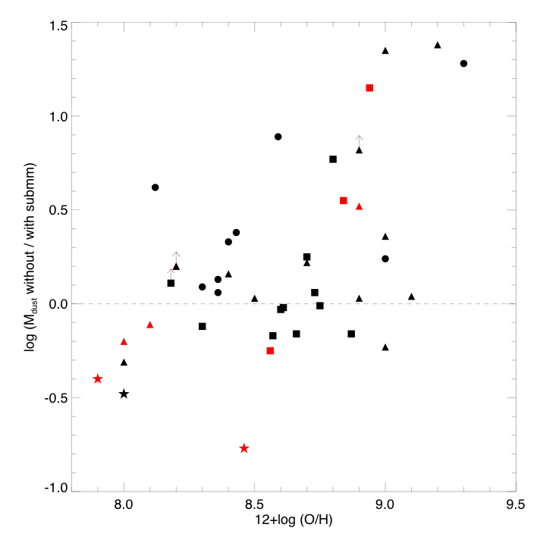
4
Evolution of the D/G mass ratio
➔ Effects of the submm constraints
- Submm constraints affect the M_{dust} for high-Z galaxies
- When M_{dust} _{with / without submm} >0 : usually dwarf galaxies.
Galametz et al. 2009B in prep

Slide 17
5
Summary
- We present the first LABOCA images of faint galaxies
For 2 galaxies, we choose to include an independant cold dust component with T=10K.
In all cases, we observe an increase of the dust mass while using the submm 870 μm constraint.
While using a cold dust component, we note that using an emissivity β=2 leads to unrealistic D/G mass ratios.
For Haro 11, the observed gas mass leads to a higher D/G mass ratio that expected by current chemical evolution models. It also does not fall on the SK law.
- We enlarge the sample and study the effects of using the submm constraint in the dust mass estimate of a galaxy. This effect could be linked with the metallicity of the galaxy.

Slide 18
Thank you for your attention
References:
Bendo, G. et al. 2006, ApJ, 652, 283
Dale, D. A., Helou, G. et al. 2001, ApJ, 549, 215
Draine, B. T. et al. 2007, ApJ, 663, 866
Draine, B. T. & Li, A. 2007, ApJ, 657, 810
Edmunds, M. G. 2001, MNRAS, 328, 223
Engelbracht, C. W. et al. 2008, ApJ, 678, 804
Galliano, F. et al. 2005, A&A, 434, 867
Galliano, F., Dwek, E., & Chanial, P. 2008, ApJ, 672, 214
Hirashita, H., Kaneda, H., Onaka, T., & Suzuki, T. 2008, ArXiv e-prints
James, A., Dunne, L., Eales, S., & Edmunds, M. G. 2002, MNRAS, 335, 753
Lisenfeld, U. & Ferrara, A. 1998, ApJ, 496, 145
Mathis, J. S., Mezger, P. G., & Panagia, N. 1983, A&A, 128, 212
Zubko, V., Dwek, E., & Arendt, R. G. 2004, ApJS, 152, 211

