Slide 1
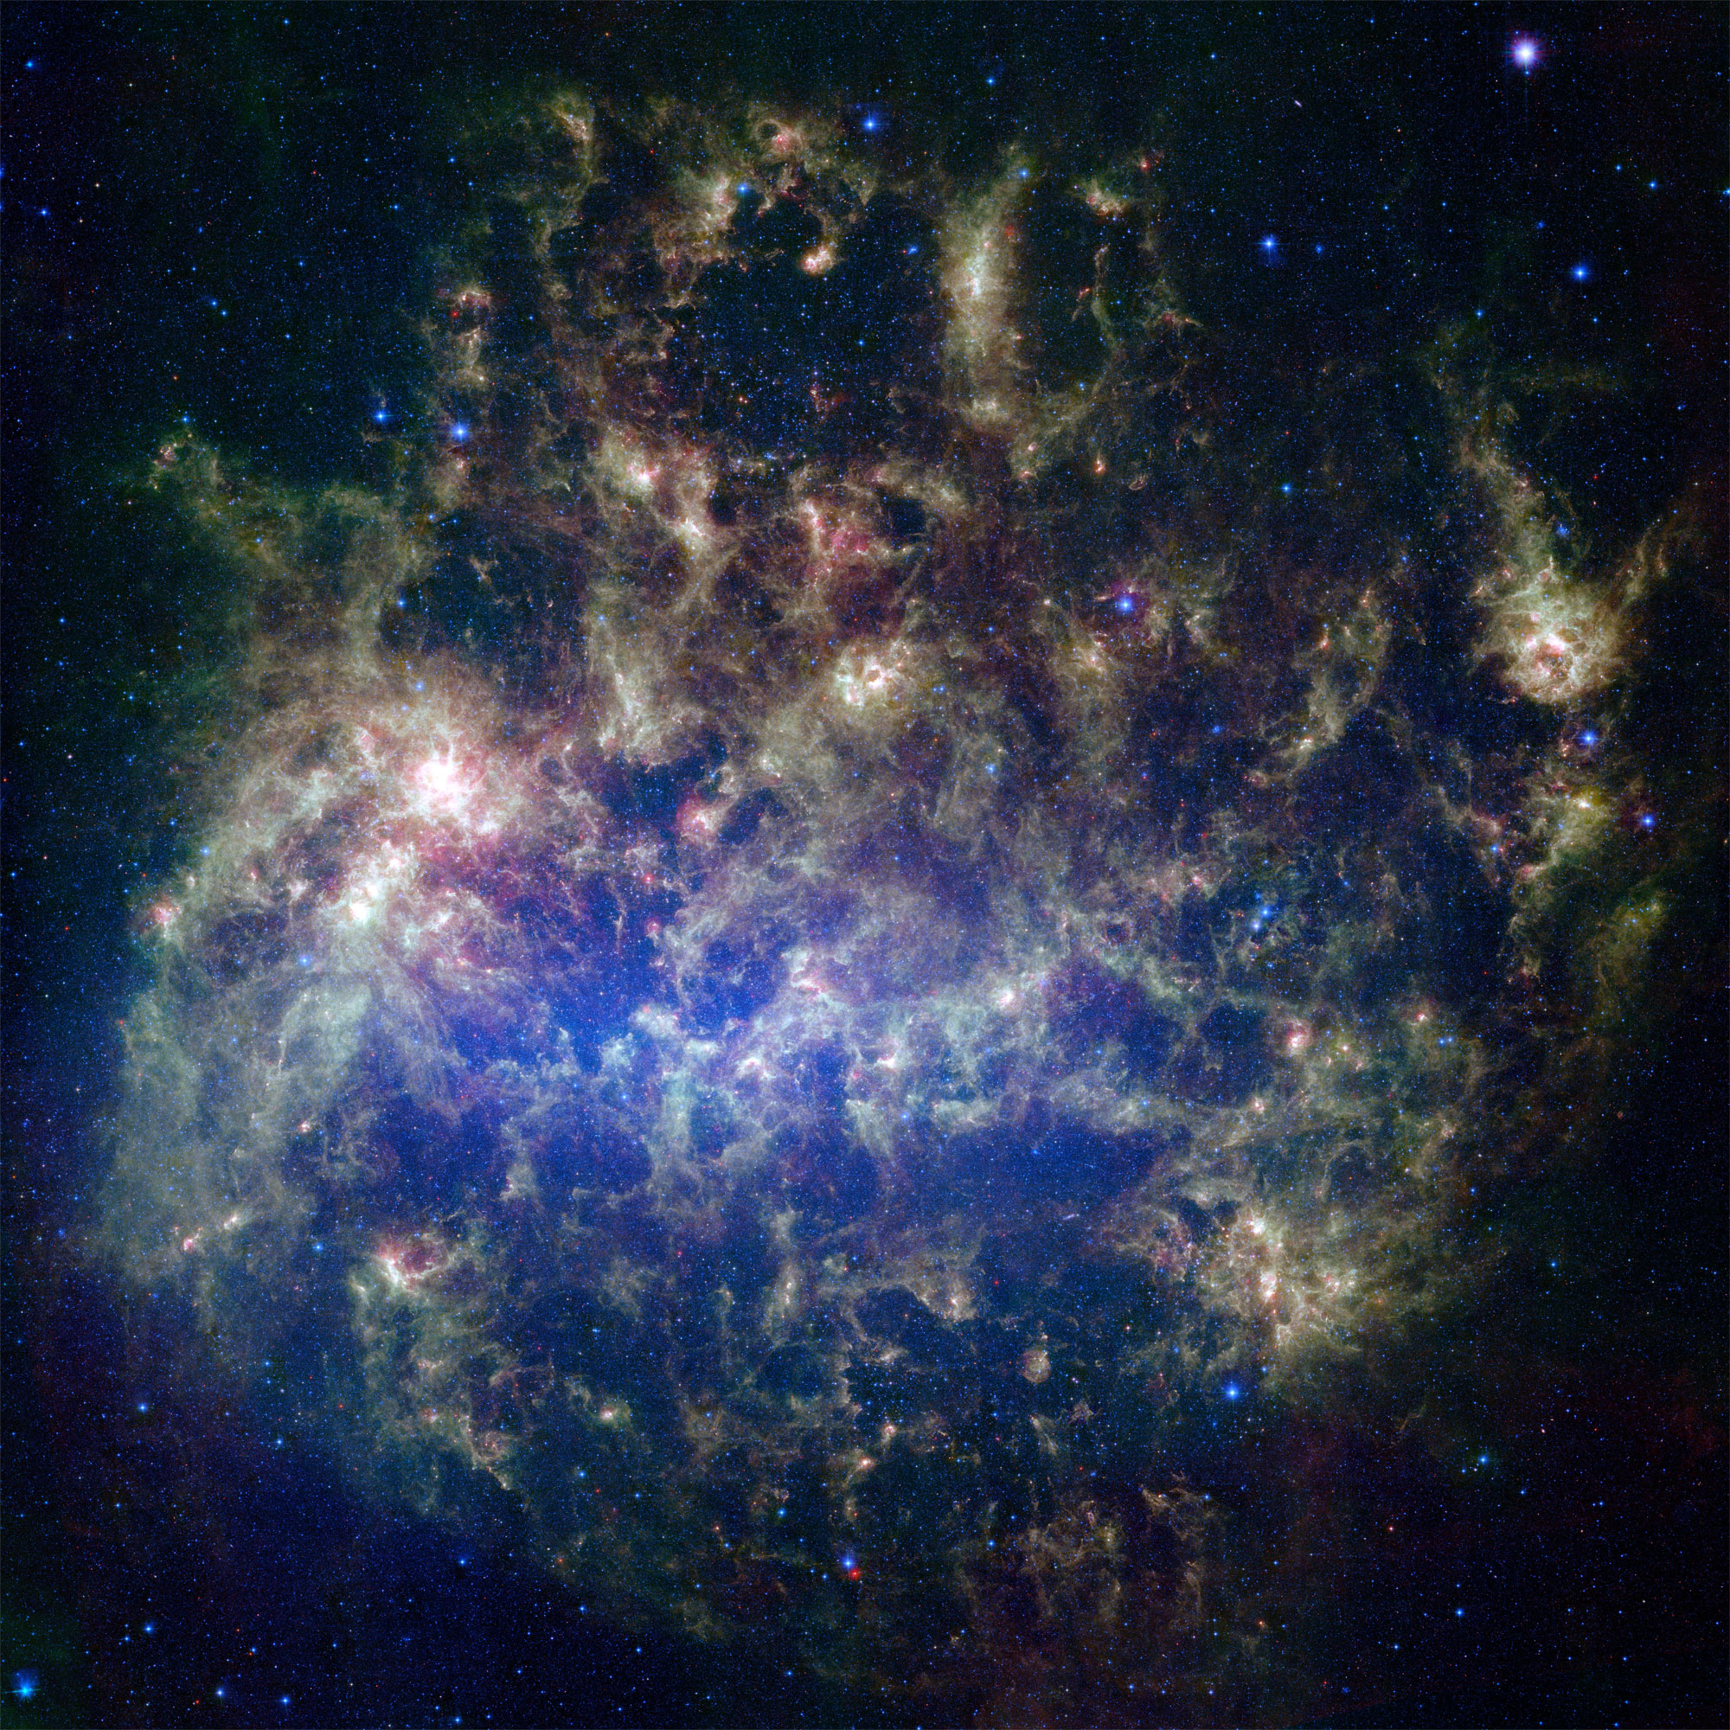
A Global View on Dust Evolution(s) from Nearby Galaxies
Frédéric Galliano (AIM, CEA/Saclay, France)
Eli Dwek (NASA/GSFC, USA)
Anthony Jones (IAS, Orsay, France)
Pierre Chanial (Imperial College, UK)

Slide 2
Content of the Talk
1) A Quick Sweep of the Dusty Universe
• Basic dust physics, the models and their constraints
• Step by step building of a spectral energy distribution (SED)
• Observed SED evolution of galaxies
2) The Dust Evolution Cycle and the Observed Dust Budget in Galaxies
• Open questions about dust evolution: sites of formation, efficiency of destruction
• Difficulties to interpret an observed galaxy's SED
3) Bridging the Gap Between the Distant Universe and Nearby Galaxies
• A multiphase SED model
• A consistent dust and elemental evolution model
• The distinct evolution of PAHs and SN-condensed dust as a function of time
Summary & Conclusion

Slide 3
Content of the Talk
1) A Quick Sweep of the Dusty Universe
• Basic dust physics, the models and their constraints
• Step by step building of a spectral energy distribution (SED)
• Observed SED evolution of galaxies
2) The Dust Evolution Cycle and the Observed Dust Budget in Galaxies
• Open questions about dust evolution: sites of formation, efficiency of destruction
• Difficulties to interpret an observed galaxy's SED
3) Bridging the Gap Between the Distant Universe and Nearby Galaxies
• A multiphase SED model
• A consistent dust and elemental evolution model
• The distinct evolution of PAHs and SN-condensed dust as a function of time
Summary & Conclusion

Slide 4
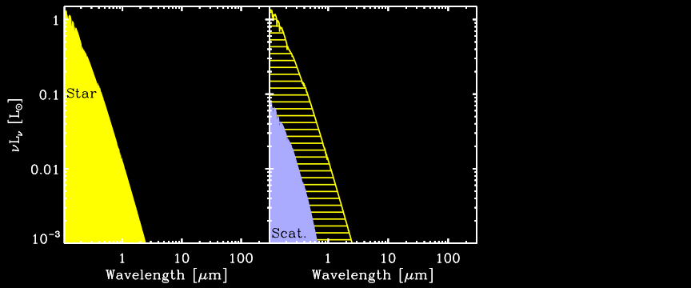
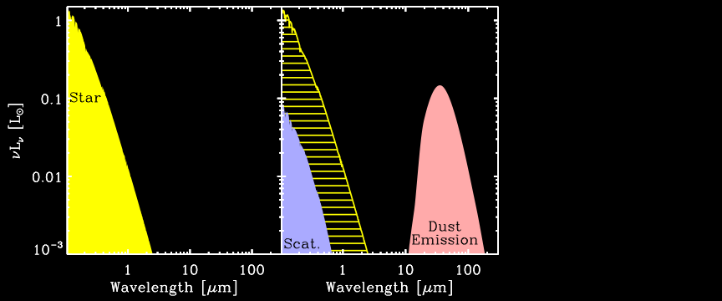
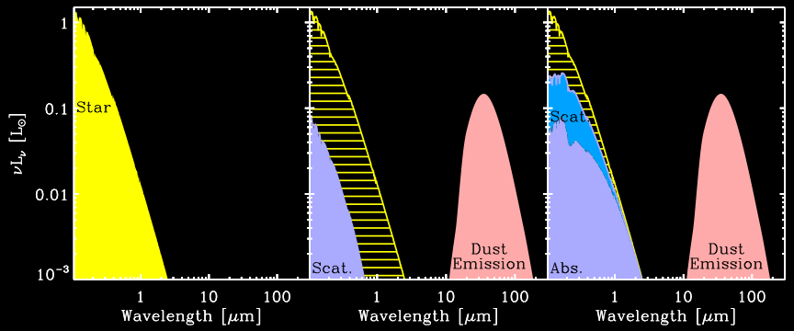
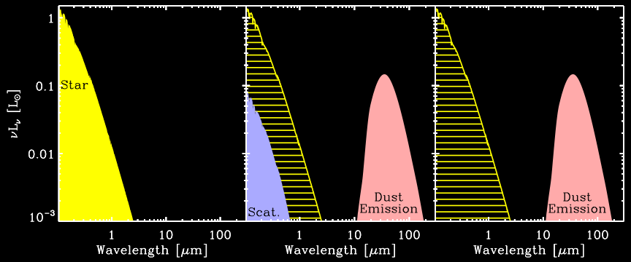
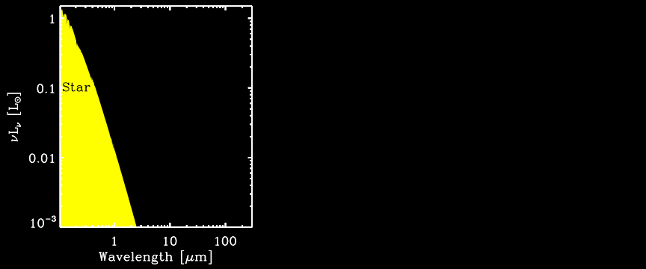
Basic Dust Physics: Absorption, Scattering, Emission
Unattenuated light
Incident light
Grain
Thermal IR reprocessing
Radiation source
Scattered
light

Slide 5
A Few Facts About Dust
• It is ubiquitous. At first order, its mass abundance is ≈1/3 of the metals
=> M_{dust}/M_{gas} ≈ 1/100×Z/Z.
• In our Galaxy, it reprocesses ≈30 % of the stellar power. In a starburst, it is ≈99 % (embedded star formation).
• It has a crucial role in the cooling and heating of the photodissociation regions: photoelectric effect => far-IR fine structure line pumping.
• It plays a role of catalysts in many chemical reactions. H₂ is formed on grain surfaces.
• The most accurate dust models are currently constrained from observations of the Galactic diffuse ISM. They account for the following constraints:
— the IR-to-mm emission (Zubko et al. 2004; Draine & Li 2007);
— the UV-to-near-IR extinction curve (Zubko et al. 2004; Draine & Li 2007);
— the elemental depletions (Zubko et al. 2004);
(— the X-ray scattering halos; Dwek et al. in prep).
=> abundance & size distribution of the various dust types.

Slide 6
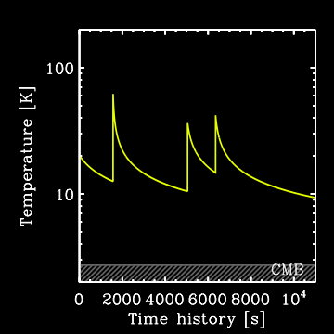
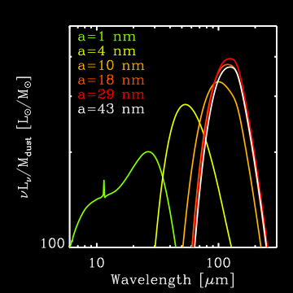
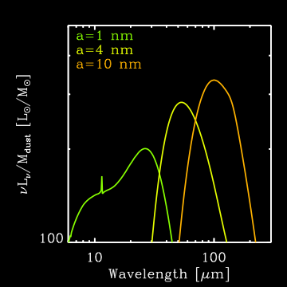
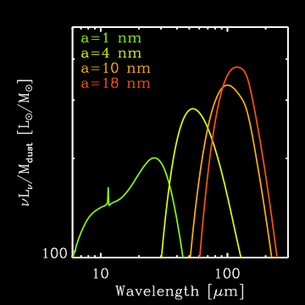
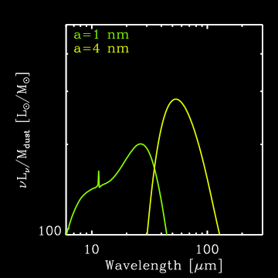
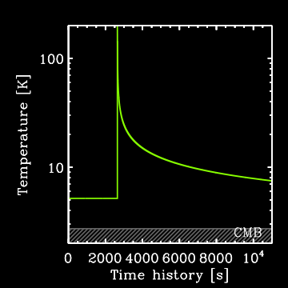
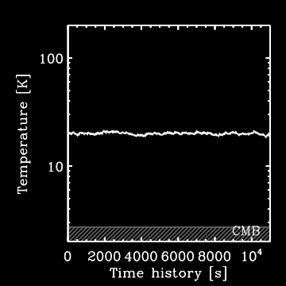
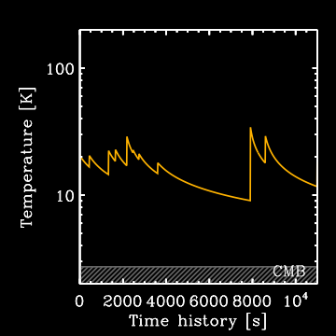
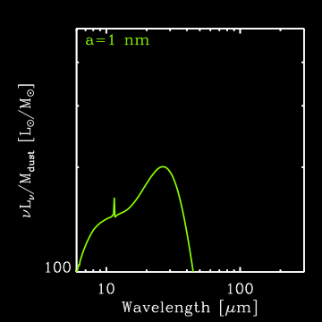
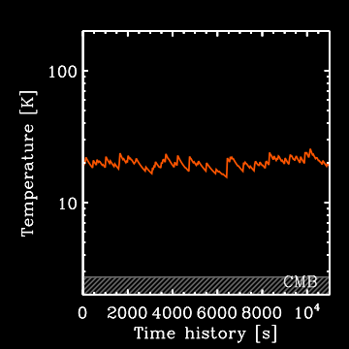
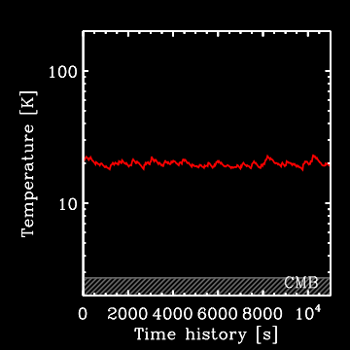
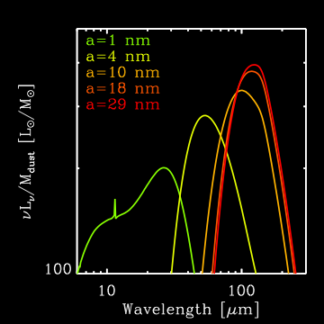
Stochastic Heating: Temperature Fluctuations
Very small grains (radius < 0.01 µm) are out of equilibrium with the radiation field.

Slide 7
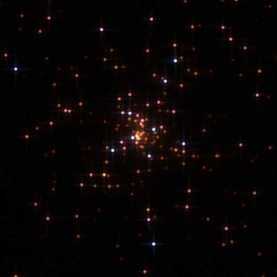
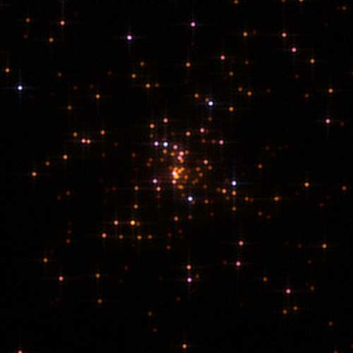
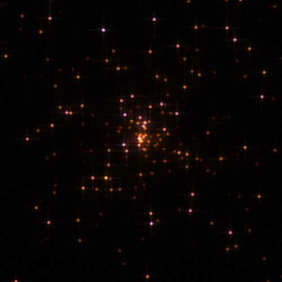
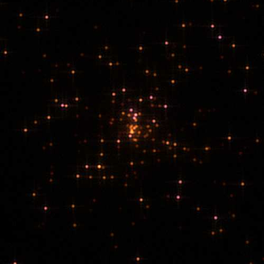
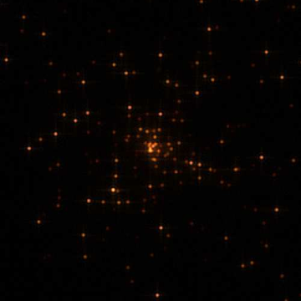
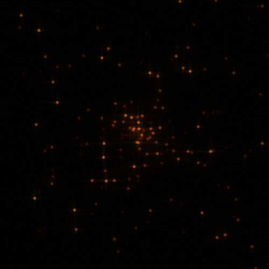
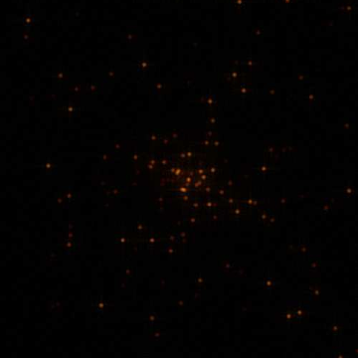
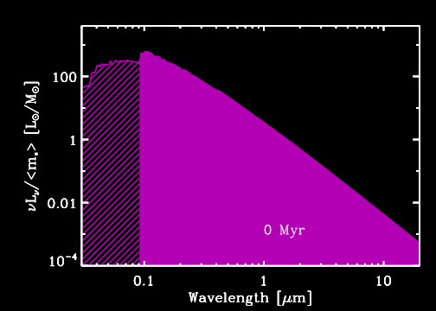
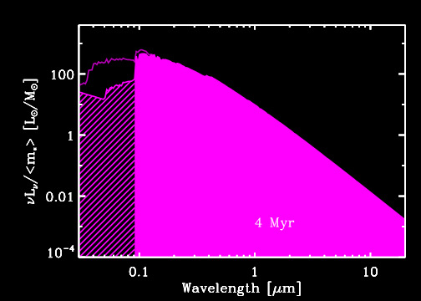
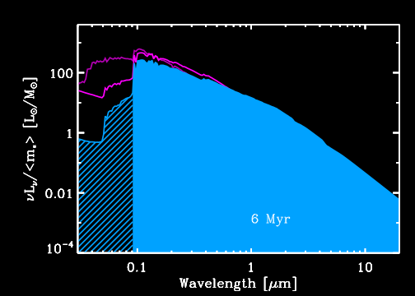
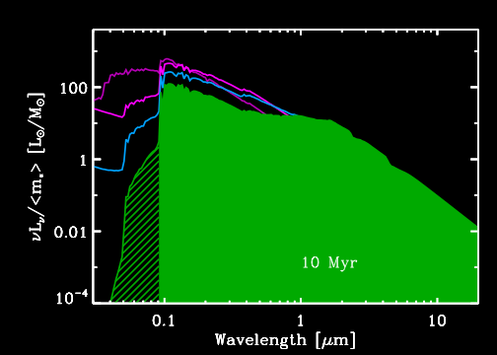
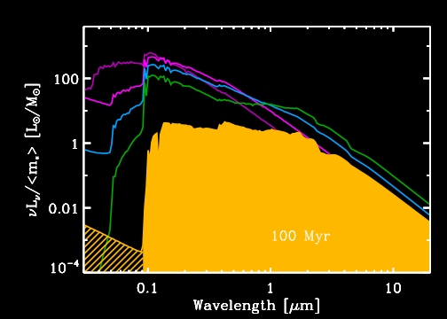
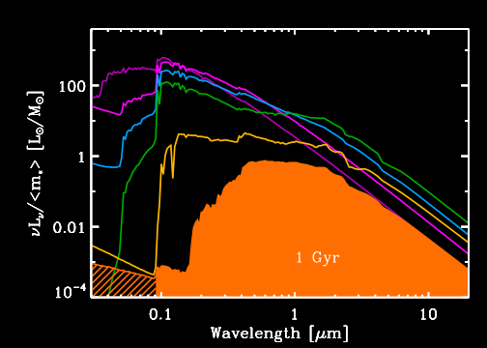
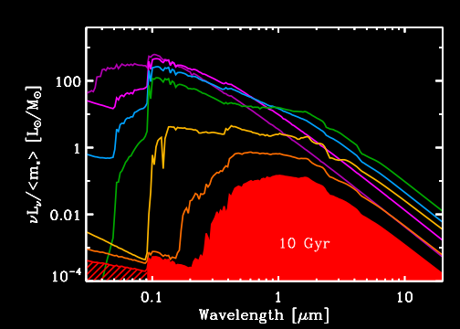
Stellar Evolutionary Synthesis

Slide 8
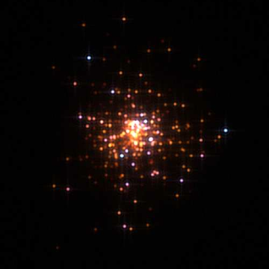
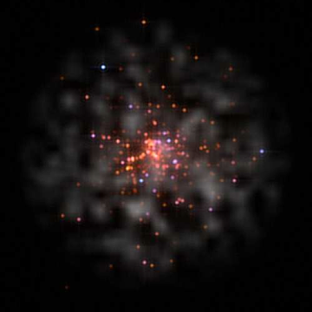
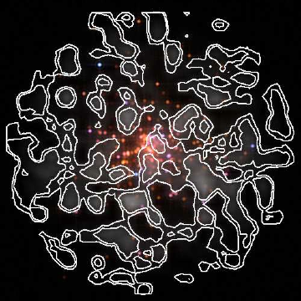
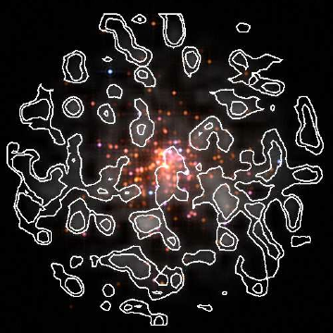
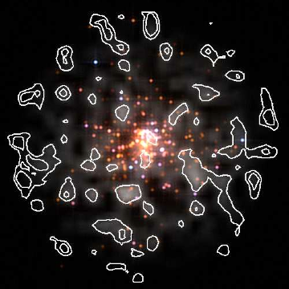
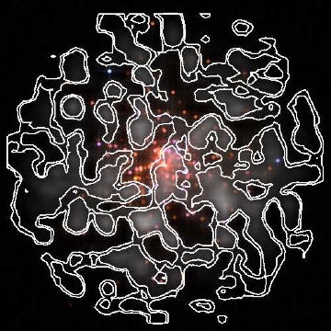
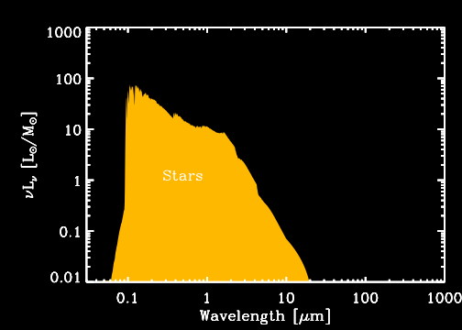
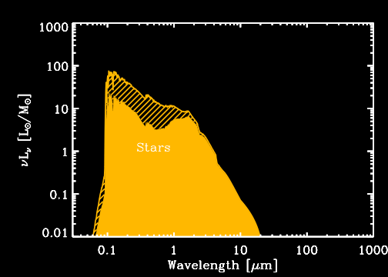
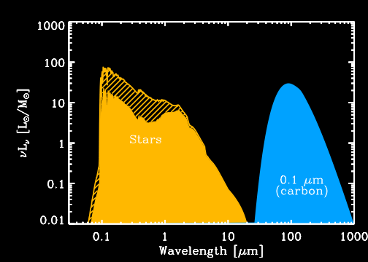
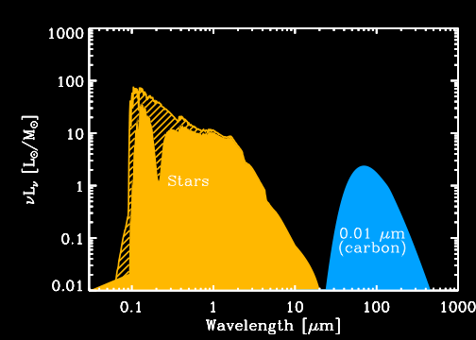
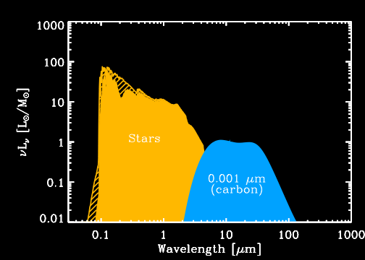
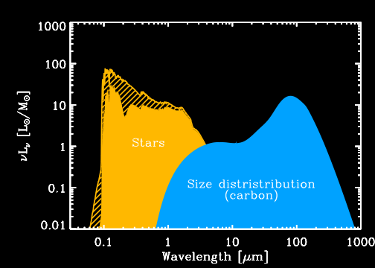
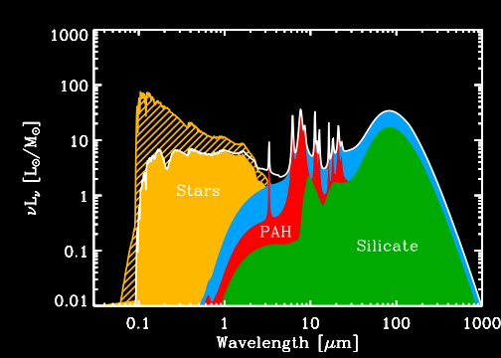
Dust Properties & Spectral Energy Distributions

Slide 9
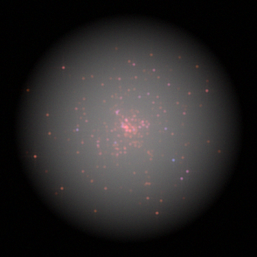
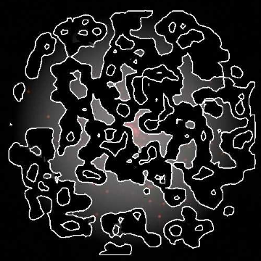
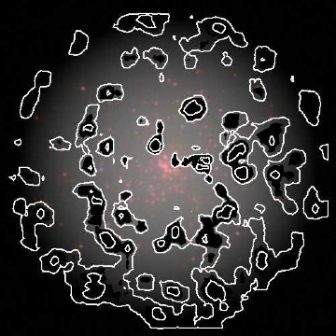
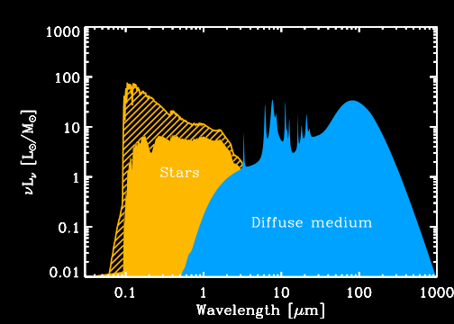
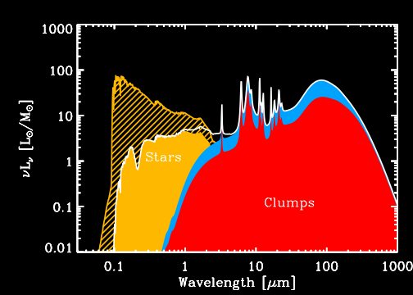

Effects of the Morphology of the ISM

Slide 10
Content of the Talk
1) A Quick Sweep of the Dusty Universe
• Basic dust physics, the models and their constraints
• Step by step building of a spectral energy distribution (SED)
• Observed SED evolution of galaxies
2) The Dust Evolution Cycle and the Observed Dust Budget in Galaxies
• Open questions about dust evolution: sites of formation, efficiency of destruction
• Difficulties to interpret an observed galaxy's SED
3) Bridging the Gap Between the Distant Universe and Nearby Galaxies
• A multiphase SED model
• A consistent dust and elemental evolution model
• The distinct evolution of PAHs and SN-condensed dust as a function of time
Summary & Conclusion

Slide 11
Motivation: Cosmic Dust Evolution
• To constrain dust evolution models: need measure of the variation of dust abundances with time.
• Nearby galaxies are crucial: wide range of metallicity and physical conditions.
• However, the global SED of a galaxy is the intricate combination of different phenomena:
  Long timescale processes (≈ 1 Gyr): elemental enrichment, evolution of the stellar populations (traced by Z_{gas});
  Short timescale processes (≈ 10 Myr): massive stars, SN blast waves, HII region evolution (traced by L_{IR}).

Slide 12








Real Life SEDs of Galaxies

Slide 13

Open Questions About Dust Evolution
• Dust formation by supernovae:
1) Individual SNe: ≈ 10⁻² M/SN (Sugerman et al. 2006; Rho et al. 2008).
2) From the distant universe: SDSS J1148+5251 at z=6.42
Age ≈ 400 Myr
L(IR) ≈ (1-2)×10¹³ L
Mdust ≈ (1-5)×10⁸ M
M(H₂) ≈ 2×10¹⁰ M
SFR(L_{IR}) ≈ 3000 M/yr
=> Dust yield ≈ 1 M/SN
(Dwek, Galliano & Jones 2007)
(Walter et al. 2004)
• Dust condensation in dense regions of the ISM: short timescales (10⁵ yr).
• The lack of PAHs in low-metallicity environments...

Slide 14





Differential Dust Evolution: PAHs vs. Dust
Paucity of PAHs in low-metallicity environments
PAH
(Madden, Galliano et al. 2006, A&A, 446, 877)
=> Need a SED model taking into account PAH destruction in HII regions

Slide 15
Content of the Talk
1) A Quick Sweep of the Dusty Universe
• Basic dust physics, the models and their constraints
• Step by step building of a spectral energy distribution (SED)
• Observed SED evolution of galaxies
2) The Dust Evolution Cycle and the Observed Dust Budget in Galaxies
• Open questions about dust evolution: sites of formation, efficiency of destruction
• Difficulties to interpret an observed galaxy's SED
3) Bridging the Gap Between the Distant Universe and Nearby Galaxies
• A multiphase SED model
• A consistent dust and elemental evolution model
• The distinct evolution of PAHs and SN-condensed dust as a function of time
Summary & Conclusion

Slide 16
Physical Ingredients of the Model
• General interstellar radiation field: population synthesis;
• Radiative transfer: HII regions, PDR;
• Dust model: stochastic heating, realistic optical properties for PAH⁺, PAH⁰, graphite, silicate (Zubko et al. 2004; Draine & Li 2007);
• Self-consistency: energy conservation;
• Each model parameter is constrained by the global panchromatic observed SED of 35 nearby galaxies.

Slide 17






SEDs of H II Regions
• Homogeneous spherical HII regions: constant G2D, no PAHs.
• Radiative transfer: competition between gas and dust for absorption of ionizing photons.

Slide 18







Schemtaic of the SED Model
HII regions: constraints on the density from free-free.
“PDR”: molecular clouds & diffuse ISM.

Slide 19



Panchromatic SEDs of Select Objects (1/2)

Slide 20



Panchromatic SEDs of Select Objects (2/2)

Slide 21





Evolution of the PAH and Dust Abundances
• Distinct evolutionary trends between PAHs and Dust.
• Benchmark for evolution models: comparison with theory.

Slide 22

A Model for the Evolution of Elements and Dust

Slide 23
A Model for the Evolution of Elements and Dust

Slide 24
A Model for the Evolution of Elements and Dust

Slide 25
A Model for the Evolution of Elements and Dust

Slide 26
A Model for the Evolution of Elements and Dust

Slide 27


Gas and Dust Evolution: Different Progenitors
(Galliano, Dwek & Chanial 2008, ApJ, 672, 214)

Slide 28

Are the Hypotheses of the Model Reasonable?
Production of PAHs by post-AGB stars?
• Evidence from mid-IR observations
• In other progenitors, the physical conditions are not appropriate.
Cerrigone et al. (2009)
Is a continuous star formation history realistic?
=> Survey of the dwarf galaxies of the local volume (Lee et al. 2009), starbursts are responsible for only a quarter of the star formation over the history of the galaxy.
How relevant is the dust production by stellar progenitors?
Dust condensation in molecular clouds in ≈10⁵ yr => indistinct

Slide 29


Dust Evolution: Delayed Injection of PAHs
Paucity of PAHs in low-Z: delayed injection of carbon dust condensed in AGB stars.
Bulk of the dust emission: SN-condensed dust.
Outlyers: very cold dust or chaotic star formation history?
(Galliano, Dwek & Chanial 2008, ApJ, 672, 214)

Slide 30
Confirmation at Resolved Spatial Scales?
SAGE: Spitzer survey of the LMC: PAH enhancement spatially associated with AGB stars (Paradis et al. 2009).

Slide 31
Content of the Talk
1) A Quick Sweep of the Dusty Universe
• Basic dust physics, the models and their constraints
• Step by step building of a spectral energy distribution (SED)
• Observed SED evolution of galaxies
2) The Dust Evolution Cycle and the Observed Dust Budget in Galaxies
• Open questions about dust evolution: sites of formation, efficiency of destruction
• Difficulties to interpret an observed galaxy's SED
3) Bridging the Gap Between the Distant Universe and Nearby Galaxies
• A multiphase SED model
• A consistent dust and elemental evolution model
• The distinct evolution of PAHs and SN-condensed dust as a function of time
Summary & Conclusion

Slide 32
Summary & Conclusion
• Phenomenological model for global UV-to-radio SEDs of galaxies:
  Determine the contribution of HII regions to the total SED;
  Take into account stellar evolution;
  Self-consistency (energy balance).
• Distinct evolutionary trends between PAHs and Dust.
• Dust abundance correlated with SN-dust production: consistent with high-z QSO, although dust formation in the ISM can not be excluded.
• Paucity of PAHs in low-Z: delayed injection by AGB stars.
Prospectives:
  better mass estimates => longer wavelengths & resolving the ISM (Herschel).
  better constraints on individual formation/destruction processes (ISM studies => measure production rates).

